Slide 1
Country Level Indicators of Suicide Risk: Data Analysis and Decision Making Support for Policy Makers
Team 25: ISyE 6414 Spring 2020

Slide 2



Team Members: Team 25
Background Information on Team (add a picture)
Little bit of get to know you
Osman Ghandour
MS in __
Aerospace Systems Design Lab
From Austin, TX
Hobbies: Running & Mtn Biking
Sam Garcia
MS in Statistics
(Part-time - ISyE)
From San Juan, PR
Hobbies: Software Development and Linux
Michael Szostak
MS in Aerospace
Aerospace Systems Design Lab
From Austin, TX
Hobbies: Running & Mtn Biking
Peter Williams
MS in Statistics
(Part-time - School of Math)
From Atlanta, GA
Hobbies: Running & Board Games

Slide 3
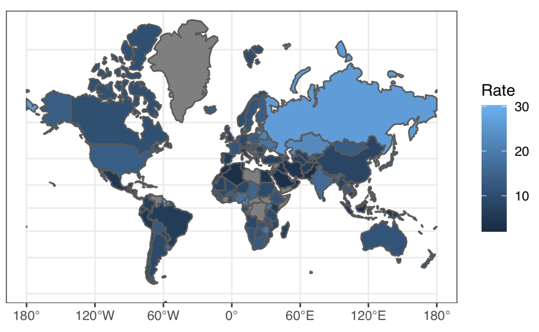
Suicide is a Global Problem With Significant Effects
Worldwide Suicide Rate by Country (per 100,000 persons)
Key Insights*
One person dies every 40 seconds from suicide
Suicide is the 2nd leading cause of death among persons 18-29
Only 38 governments worldwide have a national suicide prevention program
Sadly, many deaths attributed to suicide are preventable
*Sourced from the World Health Organization report: “Suicide: Key Facts, 2019”

Slide 4
Faltering GDP, Economic Instability & Poverty Contribute to Suicide in Zimbabwe
Africa: Suicide Rate by Country (per 100,000 persons)
Key Insights*
The WHO estimates that 19 persons per 100k take their own life deliberately in Zimbabwe (2019)
Zimbabwe has dealt with issues of endemic poverty, unemployment and hyperinflation for years which is often attributed to the policies of former dictator Robert Mugabe
Post Mugabe, Zimbabwe continues to deal with debt issues, difficulty attracting foreign investment, and currency instability which continue to contribute to systemic unemployment and poverty nationwide
*Sourced from the World Health Organization report: “Suicide: Key Facts, 2019” and the WorldBank Economic Profile of the Country of Zimbabwe

Slide 5
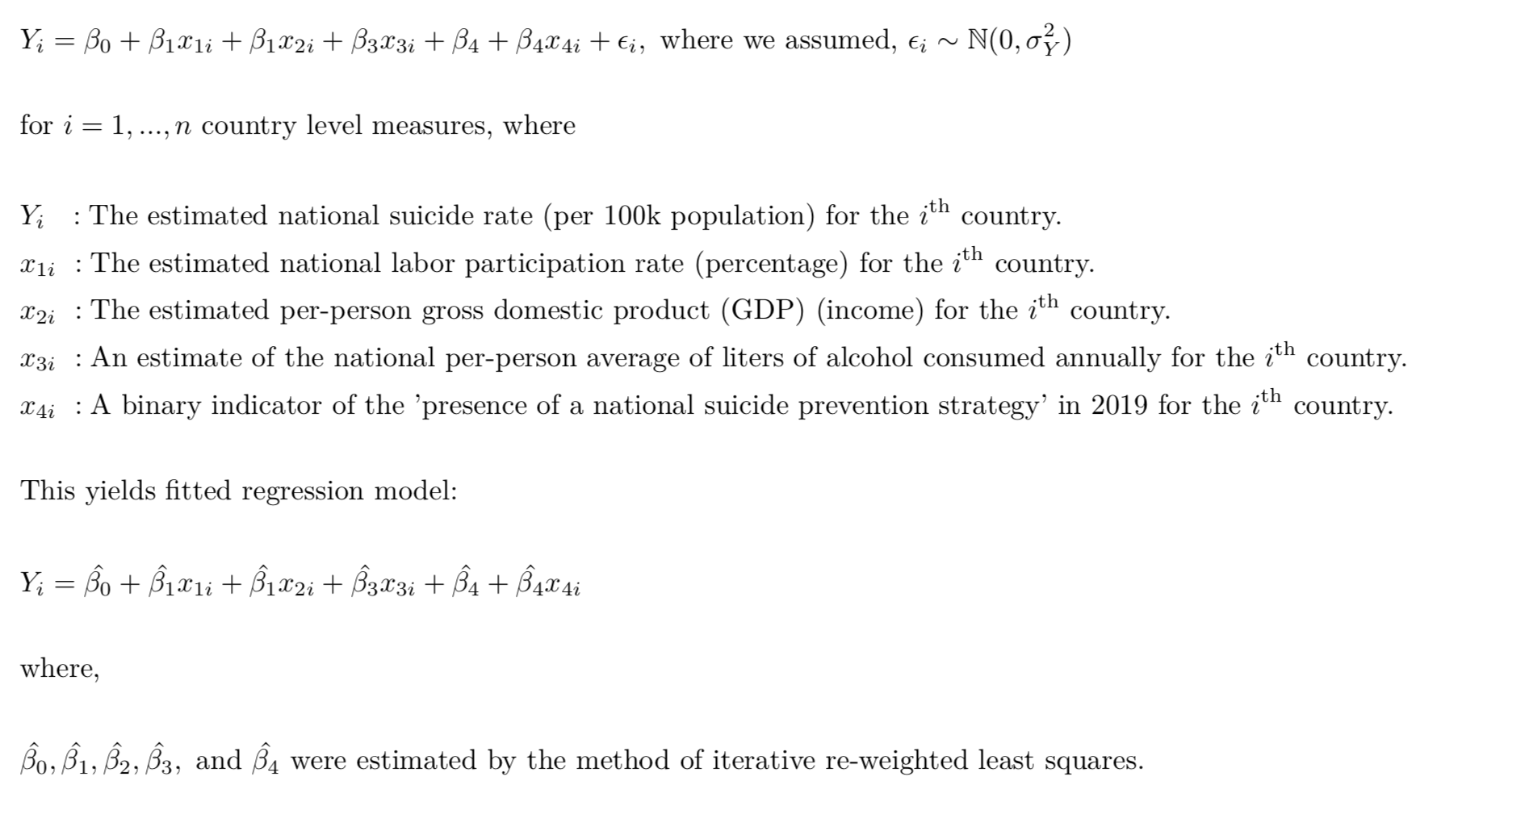
Model Specification

Slide 6
Research Motivation – Why We Chose This Topic
Suicide is a national problem, deaths are tragic, also preventable
The possibility of prevention and the scale of the problem highlight the need for policy makers, at the national level, to understand the factors that contribute to suicide not only in their respective countries but also in neighboring countries
Quick Overview of Data Sources (no need to spend a lot of time here)

Slide 7
What We Want to Share
The objective of our project is to analyze country-level and gender specific data related to suicide rates over the past ten years, and augment it with other country level data and metadata to gain an understanding and better describe rising suicide rates worldwide. Our intentions are two-fold:
To describe and identify measures and indicators that impact suicide rates at the country level for both males and females, in order to provide high-level decision making support for leaders and authors of public policy related to mental health and suicide. This includes identifying, and monitoring over time, meaningful factors and measures related to suicide prevention, for those who manage health related planning activities and priorities.
To discuss the sources, and process of collection, of data related to suicide at the country level; describe ancillary datasets that were employed to augment and enrich insights related to international differences in suicide rates. The goal is to make further research and data analysis on this topic more accessible to other interested researchers and data analysts in the future.

Slide 8
Anecdotal Evidence From the News About Highlight Countries
Pick some countries from the world heatmap and highlight specific news stories, or descriptions of the problem
Point: Motivate the contribution of the factors we are going to study further:
Economic impact: GDP (poor economic conditions – create stress)
Substance Abuse: Alcohol abuse
Mental Health Resource available (counts of professional or facilities)

Slide 9
Considered Data Sources

Slide 10
Initially considered data sources
Input | Description, Hypothesis of suicide relationship | Source
#X1 = Current_health_expenditure_percentage_of_GDP | Money spent per country on Health care. Good health care may represent healthier and longer life for citizens. Assumption is healthy life would decrease suicide | WHO [1]
#X2 = female_male_labor_participation | qqPeter
#X3 = gdp/capita ppp | qqPeter
#X4 = litres_alcohol_per_capita | Alcohol per capita consumption per year in liters of pure alcohol. Countries with higher rates of alcohol consumption tend to have higher suicide rates. By reducing the amount of alcohol consumed, suicides will be reduced.
#X5 = Suicide_prevention_strategy | qqPeter
#X6 = Psychiatrists working in mental health sector (per 100 000 population) | # of Practitioners of psychiatry per capita, as they are Mental health care personnel and can help identify mental health disorders which are linked to suicide | WHO [6]
#X7 = Mental hospitals (per 100 000 population) | qqPeter
Notes:
[x1] https://www.who.int/health_financing/topics/resource-tracking/ghed-update/en/
[x6] https://www.who.int/gho/mental_health/human_resources/psychiatrists_nurses/en/

Slide 11
Chosen Model
qqOsman
Show the model
Very brief
Show data transformations
Which Inputs were dropped
Model Explanation in later sections

Slide 12

Remaining Inputs: Health Expenditure
Current Health Expenditure as % of GDP
Data retrieved from the WHO gathered from Civil Registration records [1]
CHE is based on expenditures “including healthcare goods and services consumed during each year. This indicator does not include capital health expenditures such as buildings, machinery, IT and stocks of vaccines for emergency or outbreaks.” [2].
In 2015 CHE was 10% globally [3], and is typically higher for devolved countries
Studies in the past have seen a negative correlation between CHE and suicide rates [4]
Notes:
[1] https://www.who.int/health_financing/topics/resource-tracking/ghed-update/en/
[2] https://datacatalog.worldbank.org/current-health-expenditure-gdp
[3] https://www.who.int/gho/health_financing/health_expenditure/en/
[4] https://journals.sagepub.com/doi/pdf/10.1177/070674371005500406

Slide 13
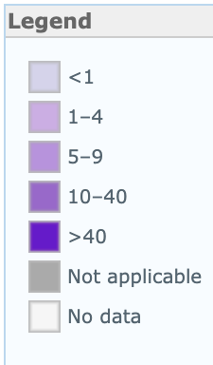
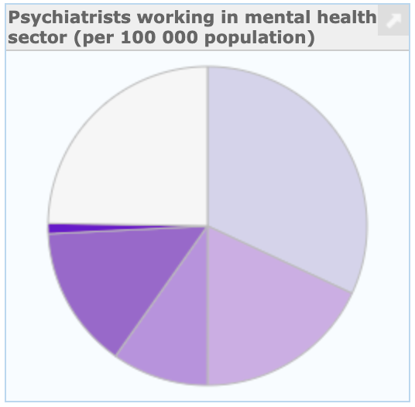
Remaining Inputs: Psychiatrists
Psychiatrists Working in Mental Health Sector (per 1000000 population)
A Psychiatrist is a practitioner of psychiatry, the branch of medicine devoted to the diagnosis, prevention, study, and treatment of mental disorders [1].
Low-income countries have 0.1 psychiatrists and the rate of psychiatrists in high income countries is 120 times greater [1]

Slide 14
Remaining Input: Alcohol Consumption
Liters of Pure Alcohol Consumed per Capita per Year
Data gathered from World Health Organization’s (WHO) Substance Abuse Country Profiles
Harmful use of alcohol is among the major risk factors for suicide
Risk of suicidal ideation, suicidal attempts and completed suicide are each increased by 2–3 times among those with Alcohol Use Disorders (AUD)
A study published in The Lancet found that global alcohol consumption saw an increase of about 70% from 1990 to 2017, going from about 21 billion liters of pure alcohol to 35.7 billion liters of pure alcohol

Slide 15
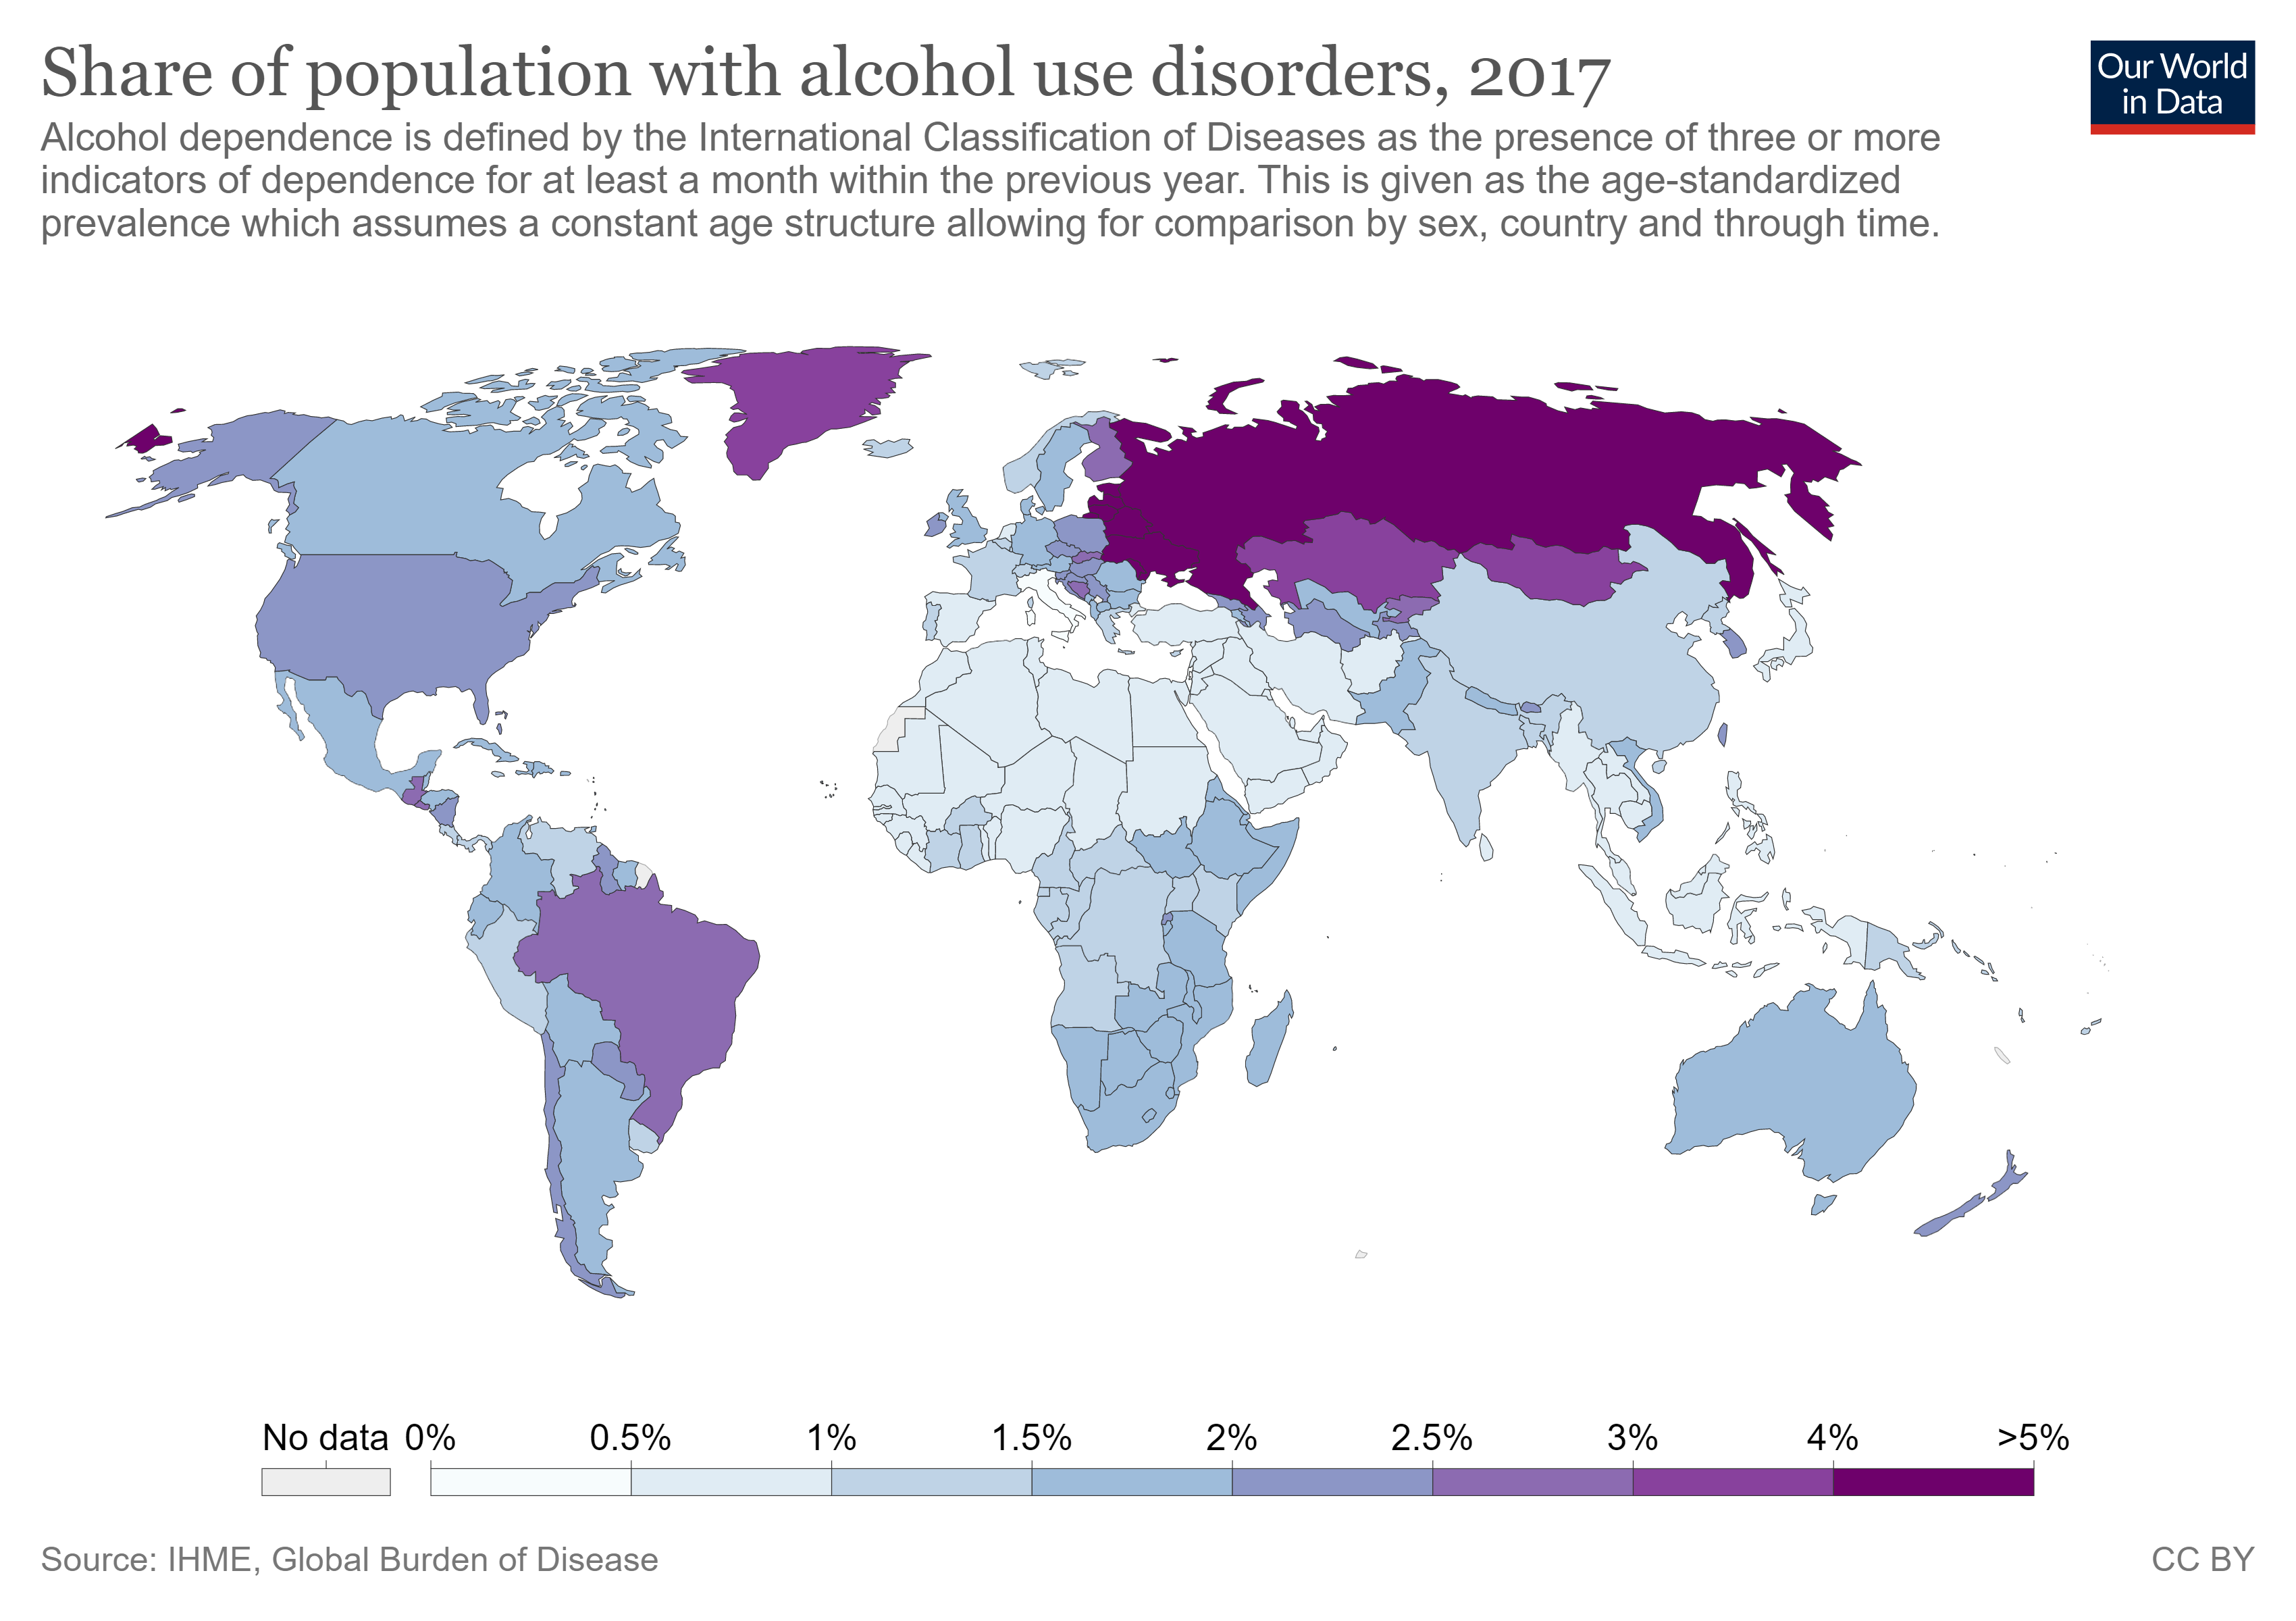
Alcohol Consumption: continued

Slide 16
Regression Model

Slide 17
Model Creation
qqOsman

Slide 18
Model Refinement
qqOsman

Slide 19
Model Limitations
qqOsman

Slide 20
Model Outcomes
qqOsman

Slide 21
Research & Data Analysis

Slide 22
What Does the Data Tell Us?
Sections:
Impact of Economic Indicators (GDP)
Impact of Substance Abuse Indications (Alcohol Abuse)
Impact of Mental Health Resources

Slide 23
Impact of Wealth, Country Level Economic Indicators
Exploratory Analysis - Visual
Testing (Hypothesis etc.)
Elasiticity/impact on our outcome
What policy makers should know

Slide 24
Impact Alcohol Abuse
Exploratory Analysis – Visual
An association exists between alcohol consumption and the rate of suicide.
Testing (Hypothesis etc.)
Countries with higher rates of alcohol consumption tend to have higher suicide rates. By reducing the amount of alcohol consumed, suicides will be reduced.
Elasiticity/impact on our outcome
Each X-unit increase/decrease in liters of alcohol consumed per capita resulted in Y-unit increase/decrease in the rate of suicide per capita.
What policy makers should know and do
Policy makers should consider implementing measures designed to mitigate the harmful use of alcohol as a means of reducing the rate of suicide.

Slide 25
Impact of Availability of Mental Health Resources
Exploratory Analysis - Visual
Testing (Hypothesis etc.)
Elasiticity/impact on our outcome
What policy makers should know

Slide 26
Impact of Availability of Mental Health Resources
Exploratory Analysis - Visual
Testing (Hypothesis etc.)
Elasiticity/impact on our outcome
What policy makers should know

Slide 27
Recommendations & Decision Making Support for Policy Makers (Prescriptive)

Slide 28
What kind of Country Level Decision Making Support This Analysis Provides
Justify investment and potential impact of decision making
Bringing up statistics that would motivate decision makers
Outlining a high-level strategy a country could take
Highlighting where policy makers could invest in additional research to better understand the problem

Slide 29
Supporting Future Researchers on This Topic

Slide 30
Conclusions & Appendix

